Slide 1
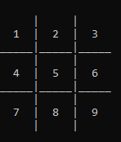
TIC TAC TOE
Kaushal Shrestha
Ishan chaulagain

Slide 2
Content
1
2
3
4
5
Introduction
Code Overview
How is DSA implement
Code mechanics
Game walkthrough

Slide 3
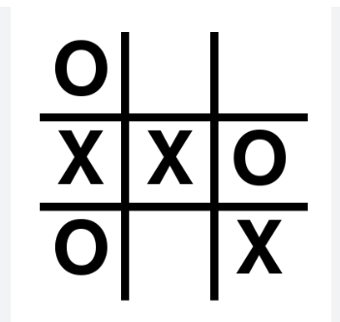
Introduction
2 player game
3X3 grind
Player make turn by marking ‘X’ and ‘O’
Three of the marks continuously wins
player wins if they get three of their marks in a row, either horizontally, vertically, or diagonally

Slide 4
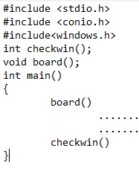
Code overview
standard libraries such as stdio.h, conio.h, and windows.h
main function initializes variables and calls the functions (board, check win).
During the loop the board function is called to display the board.
Then it enter the loop to check whether the game is draw or won by either player 1 or 2.

Slide 5
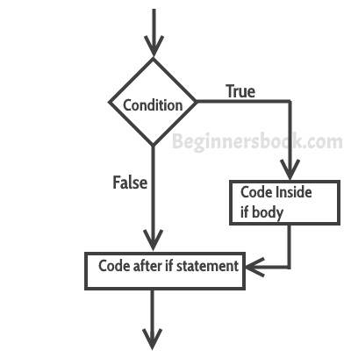
How is DSA implement
A B C D E
In our program the is just some use of DSA concept.
In the above program board is represented by using an array data structure. The function checkwin() uses sequence of conditional statement to check for winning condition. In this program we have used array to display data in board, loops to stay in the game and conditional statement to check whether the game has been draw or won by players.

Slide 6
Code walkthrough

Slide 7
Game mechanics
Player 1 is represent by ‘X’ and Player 2 is represent by ‘O’.
At 1st the board display the number from 1 to 9 in each box.
The player enter the number of square where they want to put their mark.
Checkwin() function is called to check whether the game is won or draw,
The game continuous until the game is won or draw

Slide 8

Thank you
Ishan chaulagain
(ACE077BEI016)
Kaushal Shrestha
(ACE077BEI017)

